Slide 1
🛰️ Drought Monitoring Using NDVI Anomalies in Google Earth Engine
🌍GIS CAPSTONE PROJECT
📌PROJECT IDEA:
MELISSA NAISIANOI
August 2025

Slide 2
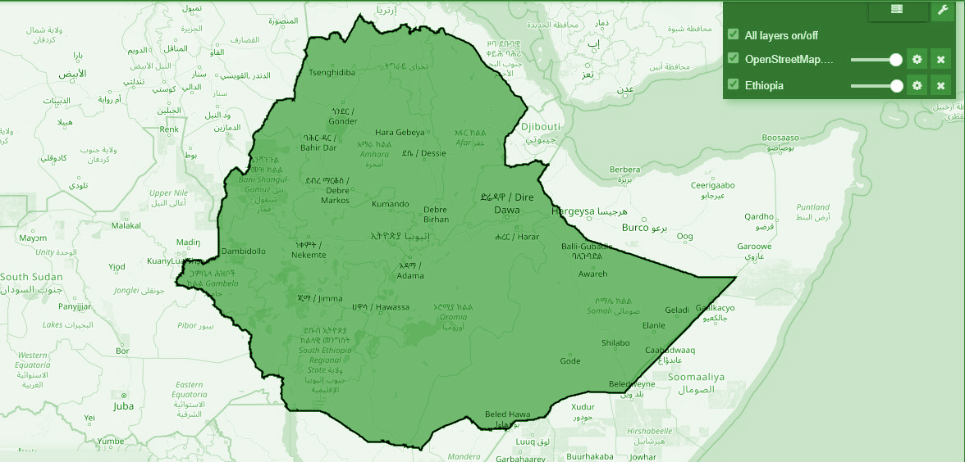
Project Overview:
Analyzed NDVI anomalies across Ethiopia (2021–2024) using Landsat 8 imagery in Google Earth Engine to detect drought patterns and support sustainable land use strategies.
Key Outputs:
NDVI Anomaly Maps (2021–2024)
Time-Series Analysis Chart
Actionable insights aligned with SDG 2 (Zero Hunger), SDG 13 (Climate Action), and SDG 15 (Life on Land) 🌱🌾🌳

Slide 3
🎯Project Objectives:
Analyze NDVI Anomalies: Compute NDVI anomalies (2021–2024, baseline 2015–2020) using Landsat 8 data in GEE to detect vegetation stress and drought-prone areas in Ethiopia. 🌾
Support SDGs: Align with SDGs 2 (Zero Hunger), 13 (Climate Action), and 15 (Life on Land) by informing drought mitigation strategies. 🌱
Demonstrate Skills: Showcase GIS (spatial analysis), Python (GEE API, visualization), and cybersecurity (secure data handling, optional encryption) skills. Deliver Outputs: Produce anomaly maps, time-series charts, a report, and a presentation for submission.📈

Slide 4

SDG Relevance:
SDG 2 (Zero Hunger): Supports food security by identifying vegetation stress. 🍎
SDG 13 (Climate Action): Enhances climate resilience through drought monitoring. 🌍
SDG 15 (Life on Land): Combats desertification via spatial analysis. 🌱

Slide 5
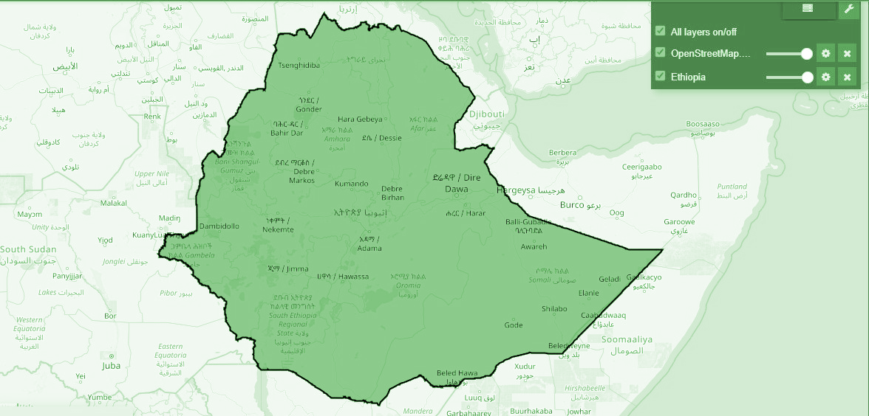
Study Area Description: Ethiopia 📍
Location: Ethiopia, ~ 1.1 million km², with diverse agro-ecological zones prone to droughts impacting agriculture. 🏞️
Data: FAO GAUL dataset (`FAO/GAUL/2015/level0`) defines Ethiopia’s boundary in GEE for precise spatial analysis. 🗺️
Visualization: Interactive map centered at [9.145, 40.4897], zoom 6, showing Ethiopia’s boundary. 📊
Insight: Boundary ensures accurate filtering of Landsat 8 data, focusing on drought-vulnerable regions like eastern lowlands. 🌍

Slide 6
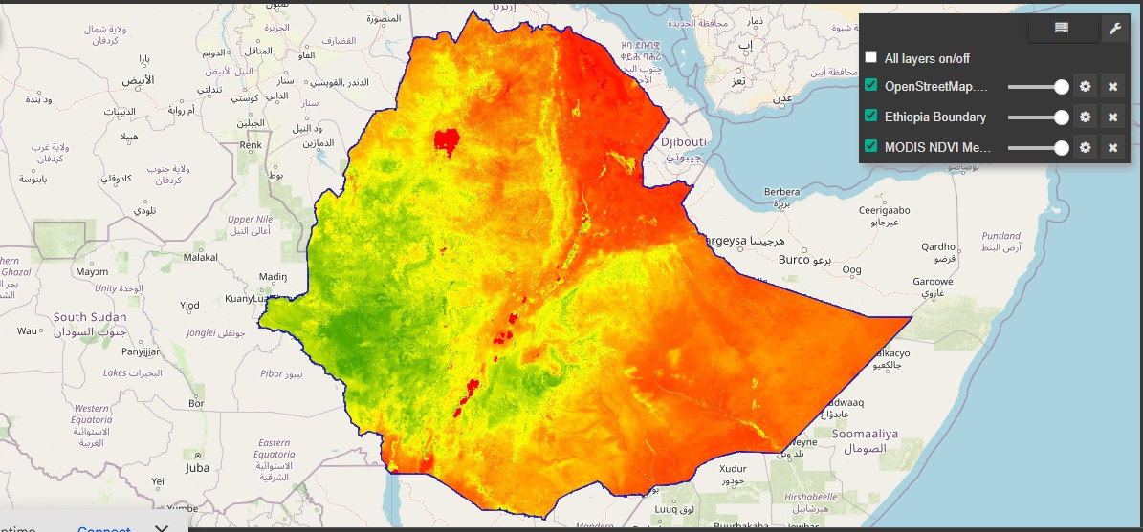
Data Sources and Processing📦
Data Source: Landsat 8 Surface Reflectance (`LANDSAT/LC08/C02/T1_L2`, 2015–2024) filtered for <30% cloud cover, yielding 9627 NDVI images. 🌾
Preprocessing:
- Calculated NDVI using NIR (SR_B5) and red (SR_B4) bands: `(NIR - Red) / (NIR + Red)`. 🧮
- Clipped to Ethiopia’s boundary using FAO GAUL dataset. 📍
-Output: 5431 baseline images (2015–2020) and 3642 anomaly images (2021–2024). 📈
- Cybersecurity: Secure GEE OAuth authentication ensured safe data access. 🔒

Slide 7
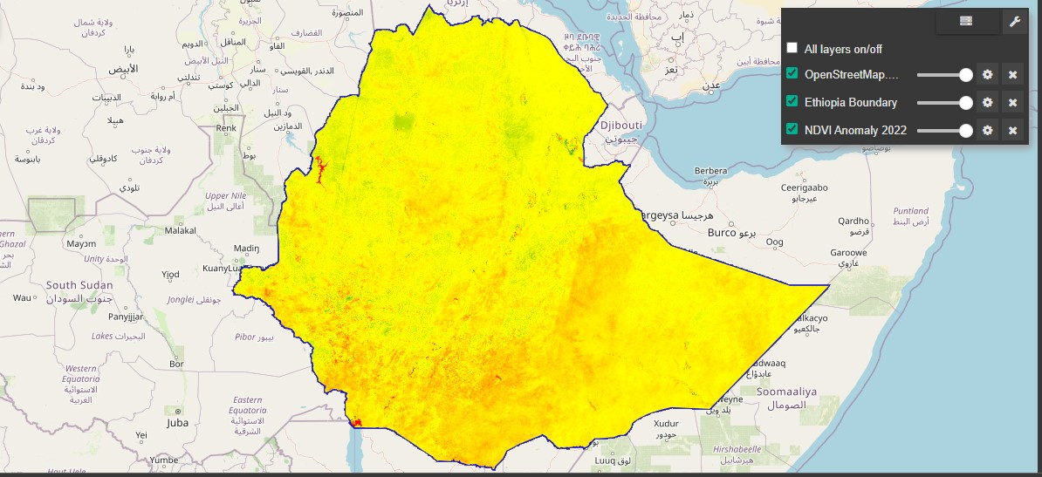
🔍GEOSPATIAL ANALYSIS SUMMARY
Insight:
Maps and chart pinpoint drought-prone regions and recovery trends for SDG-aligned interventions. 🚀
Methodology
Computed NDVI anomalies by subtracting 2015–2020 baseline mean (5431 images) from 2021–2024 NDVI (3642 images) using Landsat 8 in GEE. 🌍
- Filtered Landsat 8 data (2015–2024, <30% cloud cover) to generate 9627 NDVI images. 📊
- Calculated anomalies to highlight vegetation stress (negative values = drought). 🧮
Process
Tools
Python in Colab with `earthengine-api`, `geemap`, and `matplotlib`. 💻
(`NDVI_Anomaly_2022_Ethiopia_Landsat.png`), showing red areas for drought.
Month Year

Slide 8
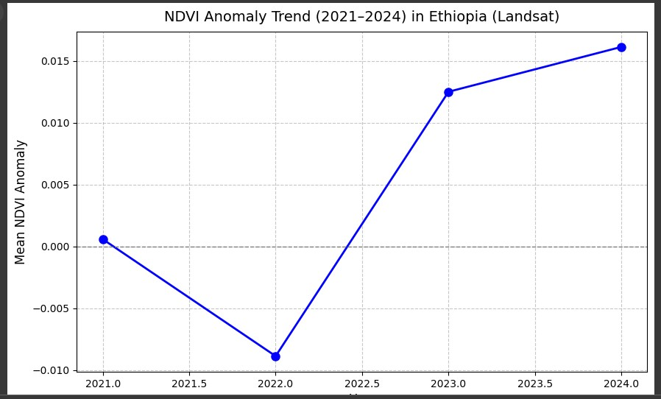
VISUALIZATION OUTPUTS:
Chart analysis
Highlights variability or land use impacts across years, with 2022 standing out as a dry year, followed by increased vegetation health through 2023 and peaking in 2024.
[ ]
Results
Mean anomalies: 2021 (0.00058, near-normal), 2022 (-0.00887, drought), 2023 (0.01250, recovery), 2024 (0.01613, strong recovery). 📈
Insight
Upward trend indicates improving vegetation health. 🌱

Slide 9
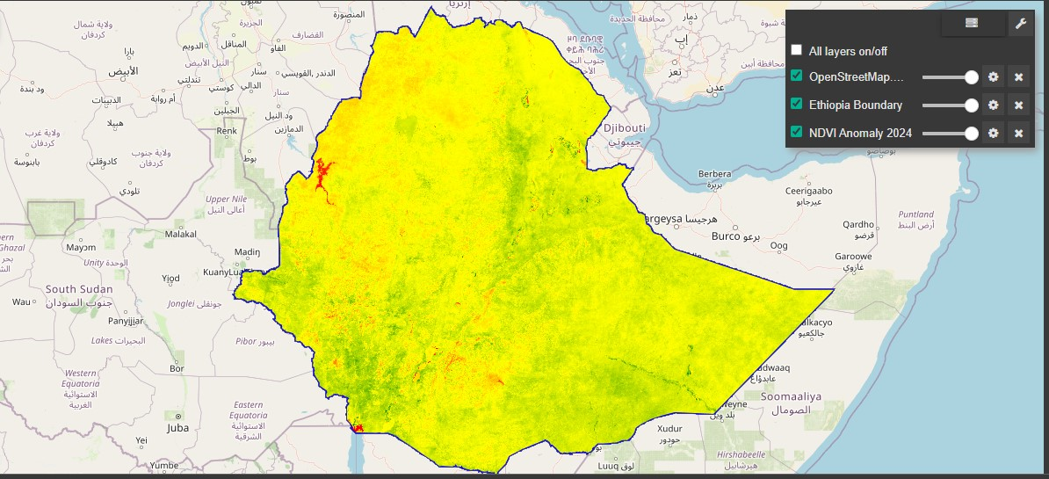
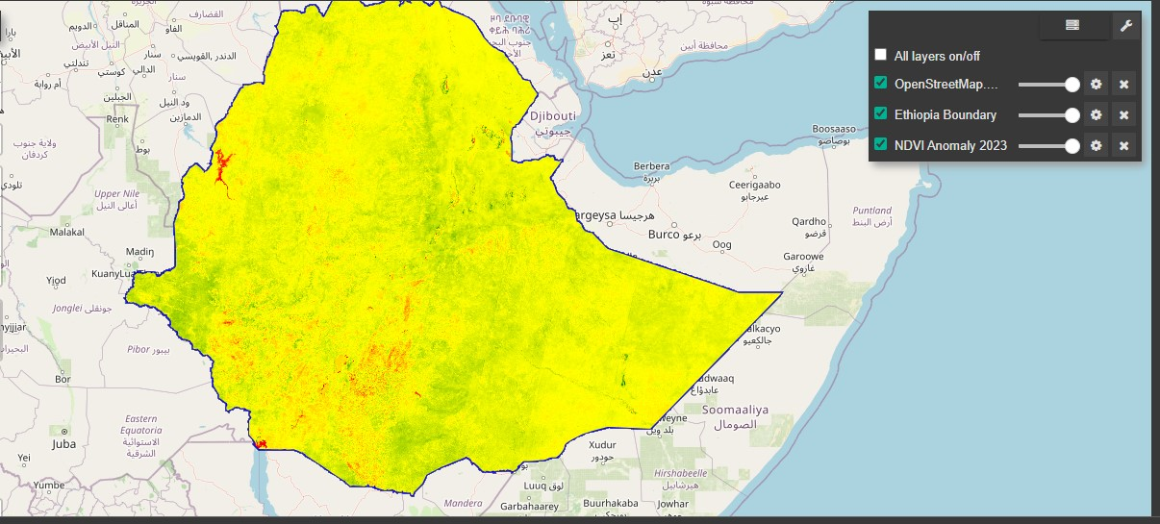
Results 📊🗺️
2022 Anomaly Map
01
03
2024 Anomaly Map
2022 (-0.00887, drought) .
The notable red shows below-average vegetation health, suggesting indication of drought or degradation.
Positive anomaly in 2024 indicates regrowth (likely eastern Ethiopia);hence recovery from 2022, supporting agricultural resilience insights. 🌱
02
2023 Anomaly Map
2023 anomaly map shows mostly yellow (neutral, ~0), some red (negative, <-0.1, drought-prone), and notable green (positive, >0.1, healthy vegetation). 🌍

Slide 10
CHALLENGES AND LEARNINGS
Challenge 1
Challenge 2
Challenge 3
→ Resolved GEE initialization errors in Colab through repeated authentication.
Handled sparse Landsat data due to cloud cover filtering (<30%),reducing image availability.
Fixed time-series chart issues by aggregating annual means and handling missing data.
LEARNINGS:
– Mastered GEE Python integration for NDVI and anomaly analysis.
– Gained skills in geospatial visualizations and data export for submission.
INSIGHT:
Overcoming technical hurdles enhanced GIS and problem-solving capabilities.

Slide 11
Conclusions and Recommendations
Findings:
Identified drought-prone areas (eg. eastern Ethiopia in 2022, -0.00887 anomaly) with recovery by 2024 (0.01613), supporting SDG 2, 13 and 15.
Recommendations:
– Integrate rainfall data to validate drought patterns.
– Scale analysis to other African regions for broader impact.
Impact:
Maps and charts guide stakeholders in drought mitigation and food security planning.
Skills:
Demonstrated GIS, Python and cybersecurity; ready for ML integration.

Slide 12
References and Datasets used
.Datasets🌍
– Landsat 8 Surface Reflectance: ‘LANDSAT/LC08/C02/T1_L2’[]( https://developers.google.com/earth-engine/datasets/catalog/LANDSAT/LC08/C02/T1_L2)
– FAO GAUL Boundary: ‘FAO/GAUL/2015/level0’[](https://developers.google.com/earth-engine/datasets/catalog/FAO_GAUL_2015_level0)
References🗺️
– Google Earth Engine Python API : https://earthengine.googlr.com/
– SDG Goals: https://www.un.org/sustainabledevelopment/
Tools📊
Python, ‘earthengine-api’, ‘geemap’ ,’matplotlib’ ,’scikit-learn’ in Google Colab.

Slide 13

Thank you for Watching!
MELISSA NAISIANOI
+254793689063
matindimelissa@gmail.com

